Slide 1
Chips and circuits
By Michiel Pauw, Lennard Visser, Hein Stroomberg

Slide 2
Problem
Moore’s law
Double amount of transistors every 18 months
Create routes/layers
Maximum 8 layers
Optimal routes
Shortest total of wires desirable
Visualization

Slide 3
Problem
Input:
Dimensions of grid
Coordinates logical gates
Net list (a -> b, c -> d, b -> c)
Output:
Layers with routes
Amount of wires
A visualization of these layers

Slide 4
Grid
Class Matrix
Default with zeros
Logical gates represented with -1
Routes represented by their number (e.g. 32)

Slide 5
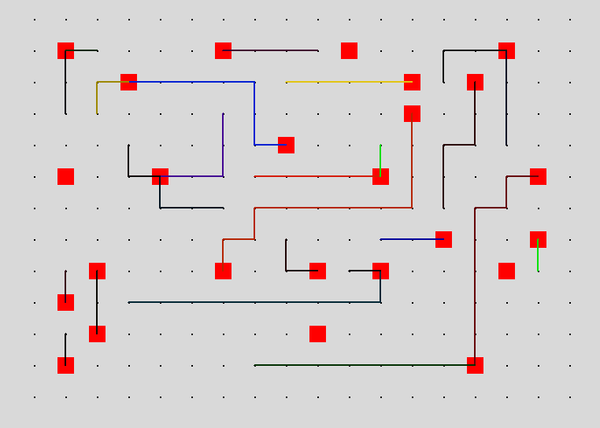
Visualization

Slide 6
Algorithms
Other
A*

Slide 7
Routes
Class Routes
Start and finish coordinate
Go left, right, up or down
If step collides with gate try another step
Layers
Go down when lines cross

Slide 8
A*
Searching optimal route
Neighbors
Score
If no options are available cross a line

Slide 9
Results
Grid 1
Net list 1 (lines = 30)
A* - 7 layers, 557 wires
Other -
Net list 2 (lines = 40)
A* - 7 layers, 657 wires
Other –
Net list 3 (lines = 50)
A* - 8 layers, 1019 wires
Other -

Slide 10
Results
Grid 2
Net list 1 (lines = 50)
A* - 8 layers, 1236 wires
Other -
Net list 2 (lines = 60)
A* - 8 layers, 1350 wires
Other -
Net list 3 (lines = 70)
A* - 8 layers,
Other -

Slide 11
Conclusion
Other finds no solutions
A* find solutions for 5/6 net list
A* better than other

Slide 12
Further research
Finding solution Grid 2 Net list 3
Find the optimal reading of the net lists, now small to big
Hill climber, Simulated Annealing and Genetic algorithm

